Slide 1

RF for Radar Workshop
Gerald Albertini
galberti@mathworks.com

Slide 2
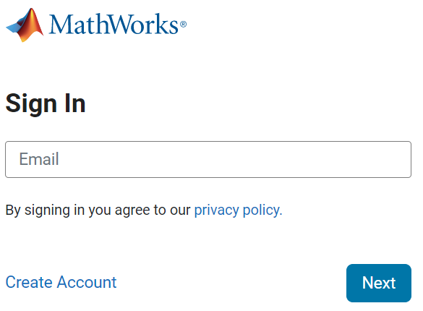
Download Workshop Files
Click the link provided to you before the workshop
If you’re not logged in with your MathWorks account, you’ll see this page
If you don’t have a MathWorks account, create one
Notes:
Get out of presentation mode and into edit mode.
Copy the link and put it in the chat of the workshop.
Have the participants click that link.

Slide 3
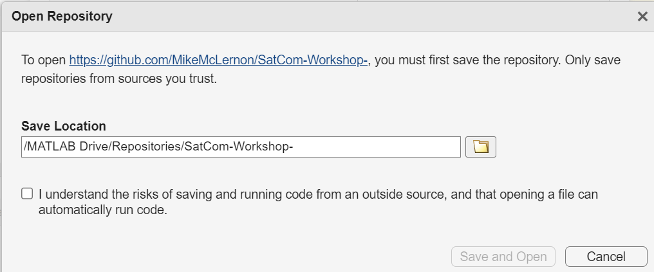
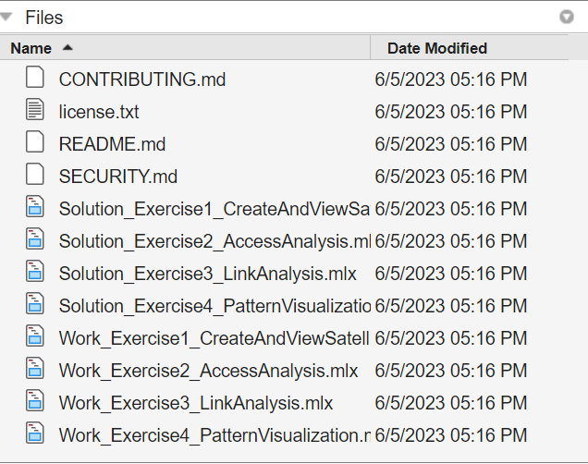
Download Workshop Files
If you click the link while logged in to your MathWorks account, you’ll see this dialog
Click the checkbox, and the “Save and Open” button
You’ll then get routed to MATLAB Online, and you should see these files
If so, you’re good to go!
Notes:
Get out of presentation mode and into edit mode.
Copy the link and put it in the chat of the workshop.
Have the participants click that link.

Slide 4
Companion Webinar
https://mathworks.com/videos/early-verification-of-radar-front-ends-with-model-based-design-1720607662320.html

Slide 5
Workshop Agenda
Radar Systems and the role of Simulation
Today’s exercises

Slide 6
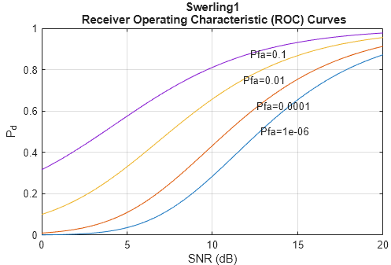
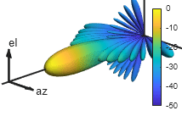
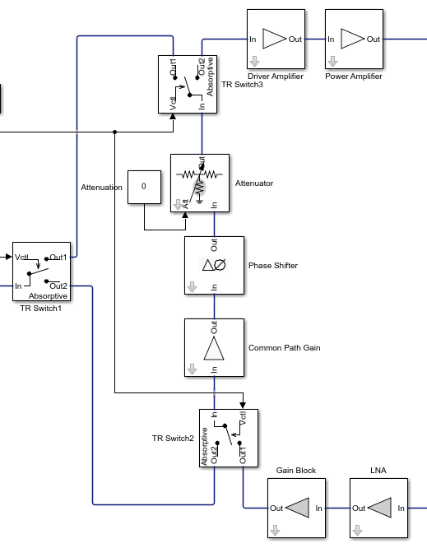
Today’s Exercises
Derive Radar specifications from high level requirements + Build a behavioral simulation to validate results
~30 minutes
Design antenna array subsystem
~30 minutes
Model RF Front-End (TR Module)
~30 minutes

Slide 7
Model Radar with Increasing Levels of Fidelity
Use radar equation to derive radar operating parameters based on system requirements utilizing the Radar Designer (Radar Toolbox)
Simulate with high-level components such as Transmitter, Receiver, Arrays to validate radar equation analysis (Phased Array System Toolbox)
Refine model with RF Budget Analyzer by specifying individual RF components of the Transmitter and Receiver (RF Toolbox)
Rerun simulation replacing high-level Transmitter and Receiver models with specific RF components (RF Toolbox)

Slide 8
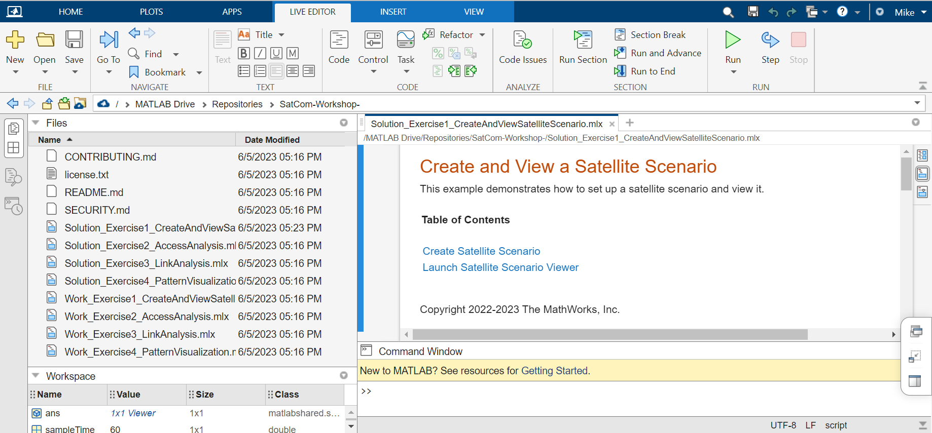
Working with the Live Editor
Notes:
Also, this workshop uses the Live Editor for its scripts, not the traditional editor. It has some nice features that make your workflow easier.
<Enter> First, all the exercises are broken up into sections, so that you can run just a section at a time, to debug your work step by step.
<Enter> You would use the “Run and Advance” button to run the current block of code, and then advance your cursor to the next block of code. Again, very helpful for debug purposes.
<Enter> And if you want to run your script from top to bottom without any breaks, just use the “Run” button.
And if you want to use the debugger for your code, it works pretty much the same in the Live Editor as it does in the traditional editor. If you need help with that, let us know and we can work with you one-on-one.

Slide 9
Coding Constructs and Practices
Value-only arguments don’t need any modifiers
Name-value pairs use property names
y = foo(...
arg1, ... % value-only argument
Name1=value1); % Name-value pair
Name=value, and “Name”,value, and ‘Name’,value are all equivalent when specifying name-value pairs
Use only one style in a given function call
Read the code comments! They contain helpful instructions to guide your code, including the usage of value-only arguments and name-value pairs.

Slide 10
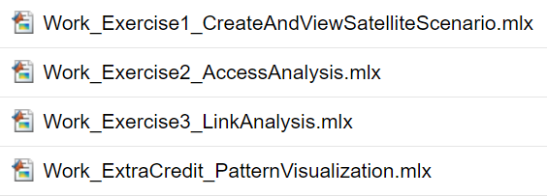

Use the Work Scripts, not the Solution Scripts
Notes:
The Work scripts are for you to edit. They have lots of comments to show you where to add code.
The Solution scripts already have the answers. They will run great, but you won’t have to do any work to get to the finish line. Best to use the Solution scripts if you are stuck trying to complete the Work scripts.

Slide 11
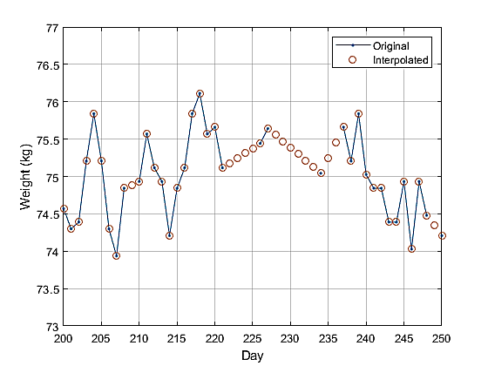
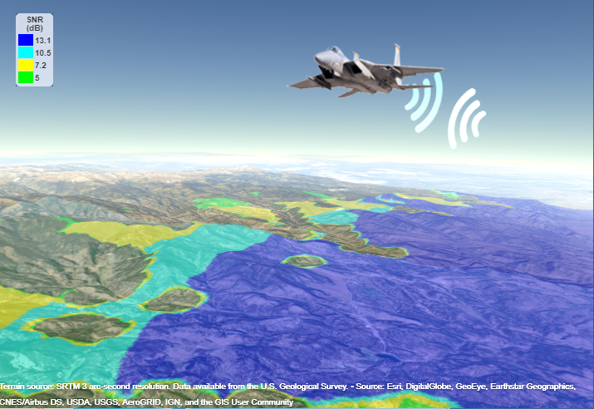
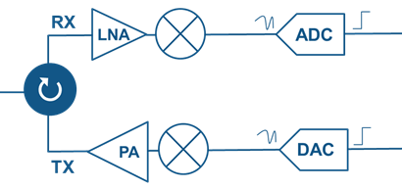
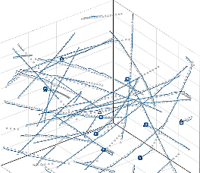
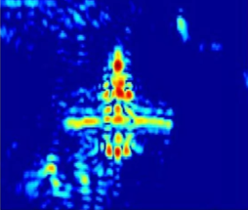

Electromagnetic Spectrum Operations Systems Domains
Signal
Processing
Antenna/RF
Data Processing
Sensor Fusion & Tracking
Classification
Resource Management & Control
Notes:
Before going further I think we all agree that an example of a complex system is a radar system. The design of such a system requires knowledge in different domains of engineering.

Slide 12
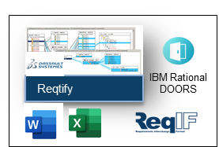
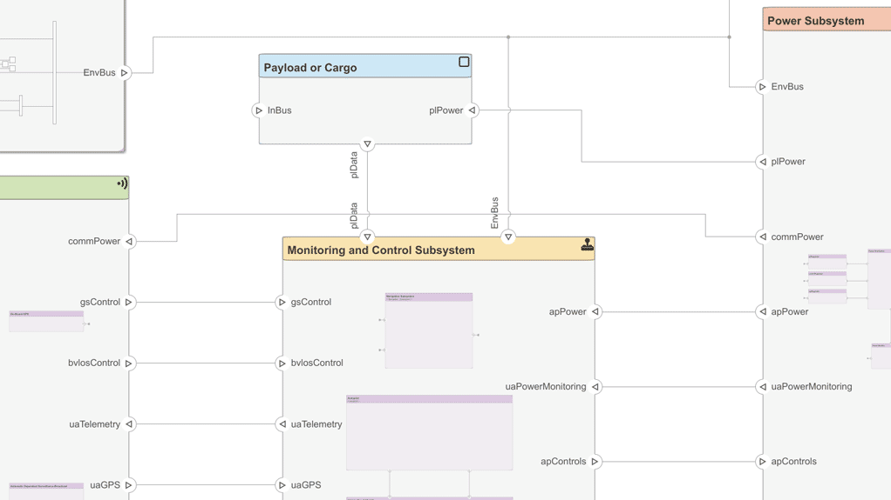
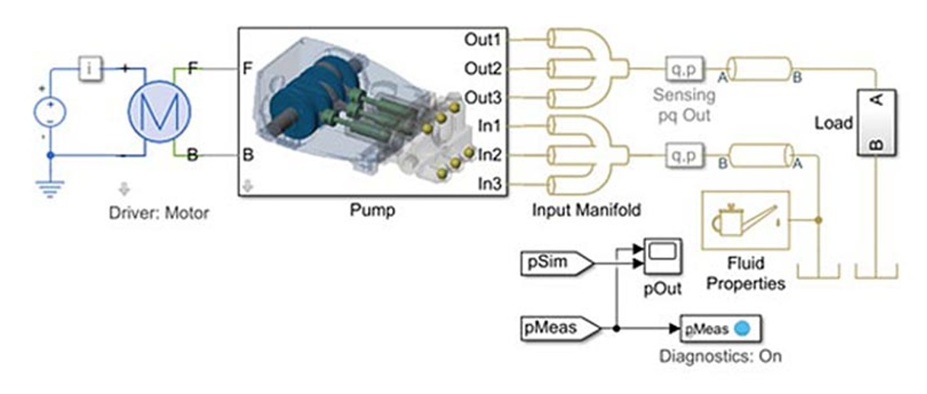
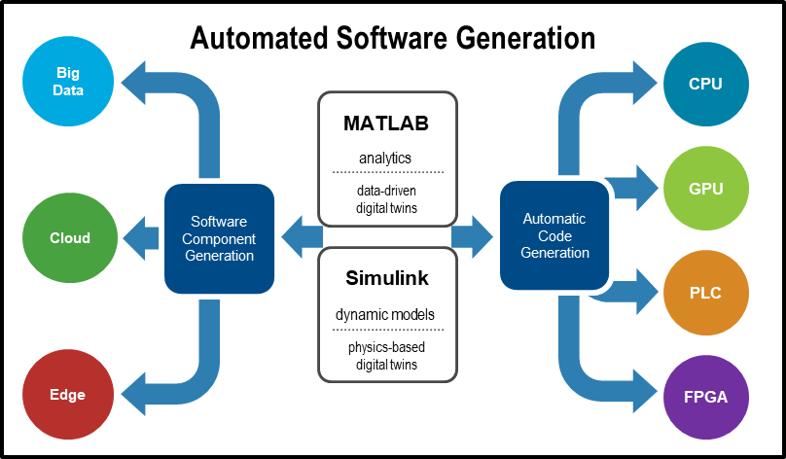
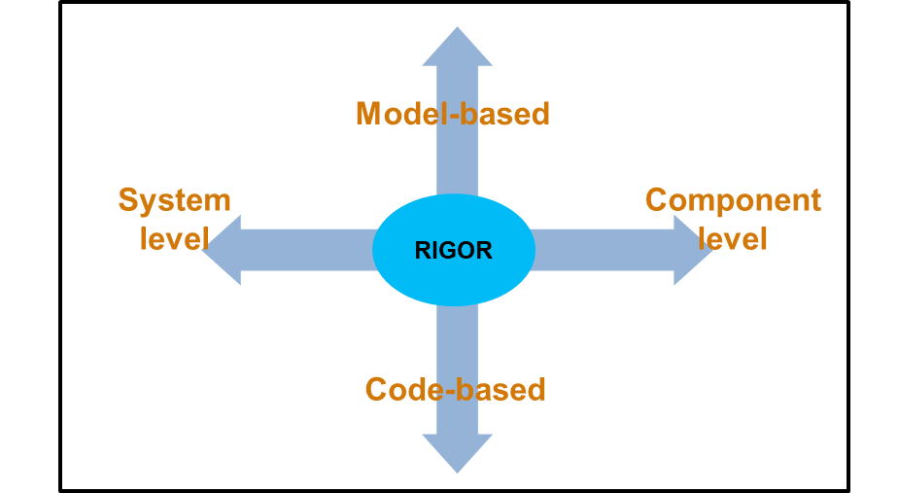

Authoritative Source of Truth ▪ Reuse/Refine ▪ Value at Multiple Stages Digital Engineering Capabilities
System Requirements
System Functionality and Architecture
Subsystem Design
Subsystem Implementation
System Integration and Test
Operations and
Sustainment
System Requirements
System Functionality and Architecture
Subsystem Design
Subsystem Implementation
System Integration and Test
Use cases
Behavior models
Physics-based
Automatic codegen
C/C++
VHDL/Verilog
GPU code
Model-based V&V
Predictive
maintenance
Requirement docs and models
Architecture models
Data-driven
Code-based V&V
Certification workflows
Digital Twins
Scenario models
Environment models
Hand-code support
Digital Thread

Slide 13
Exercise 1: System-Level Radar Specifications

Slide 14
Step 1 – Radar Specifications: Model, Analyze & Simulate, Flow-down
A. Model System Architecture
B. Identify & Allocate System Level Requirements:
Min/Max range, Minimum resolution & RCS
Operating frequency, Probability of false alarm
C. Analyze System and Derive Subsystem Spec
e.g. Design waveform and digital signal processing
Pulse bandwidth, width, repetition frequency
Number of pulses
D. Derived RF specs
Transmitter peak power
Receiver noise figure
Antenna directivity
Array size
Specs for RF system engineer / designer

Slide 15
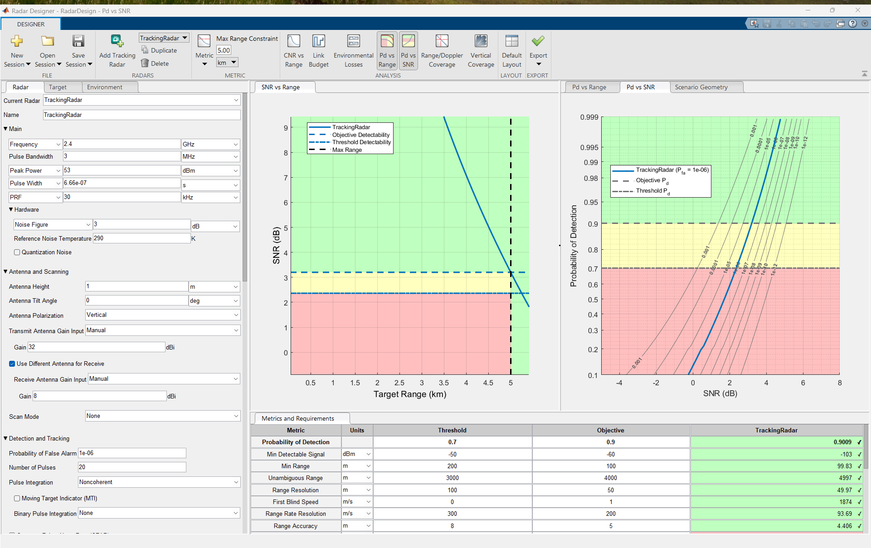
Substep C. Analyze System and Derive Subsystem Spec
DEMO
System Level Requirements
Range = 35 km
Resolution = 150 m
Center frequency = 2.4 GHz
Num pulses = 10
Radar
Designer
Derived Component Req’ts
TX peak power = 53dBm
RX noise figure = 3dB
Antenna gain = 8dBi
Array size = 8x8 (18dB)
RadarDesign.mat

Slide 16
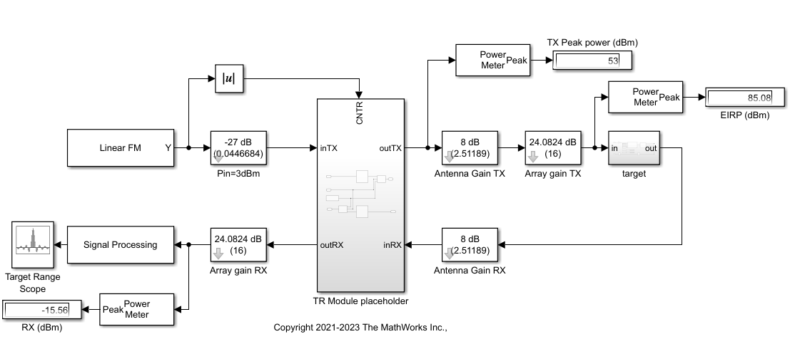
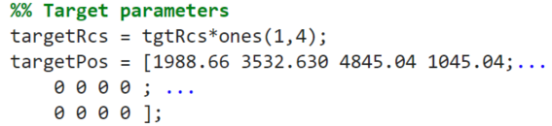
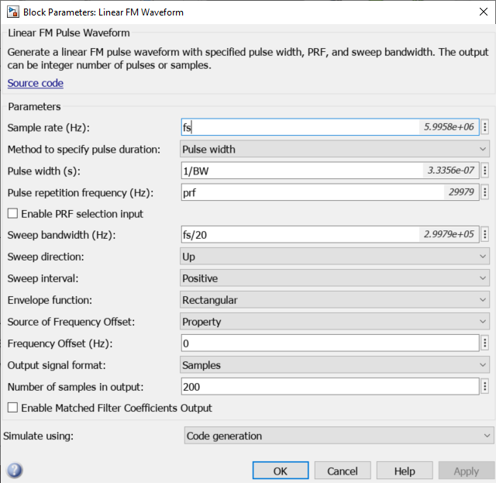
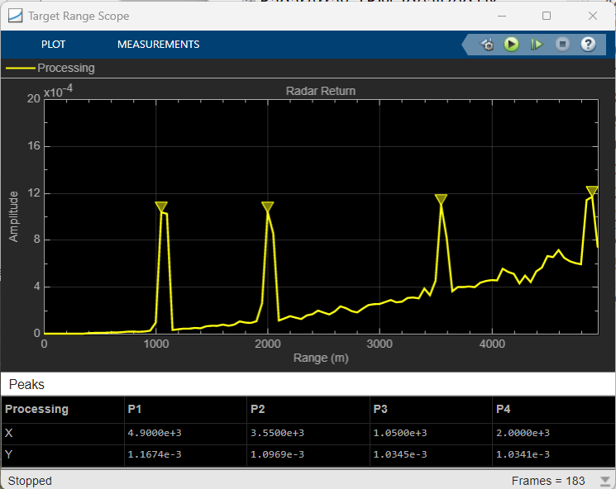
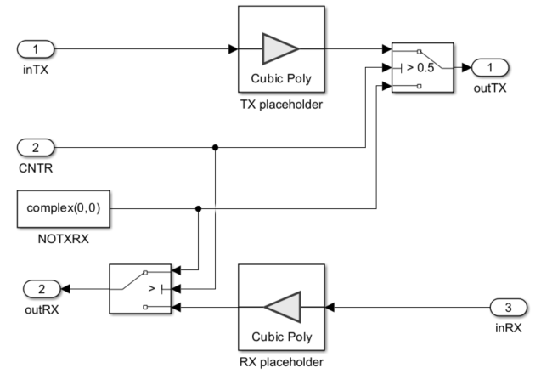

Step D. Design Model: Simulate Specs in Design Model (Baseline)
DEMO
Placeholder antenna array
Size = 16x16
Pin = 3dBm
Placeholder Antenna
Antenna gain = 8dBi
Placeholder TR module
TX Gain = 50dB
RX Gain = 39dB
RX NF = 3dB
RadarSystem.slx

Slide 17
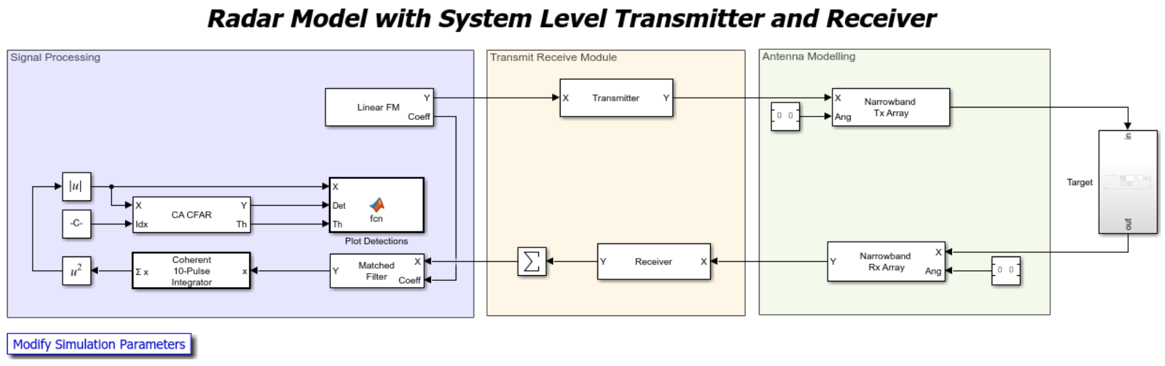
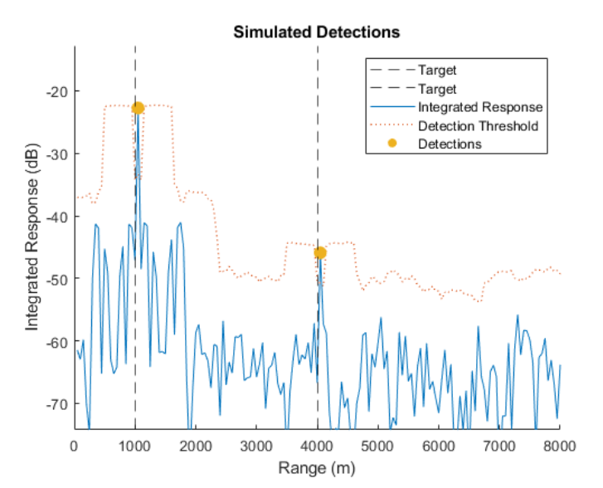
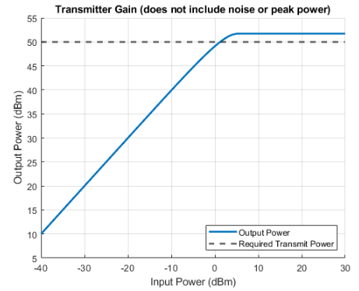
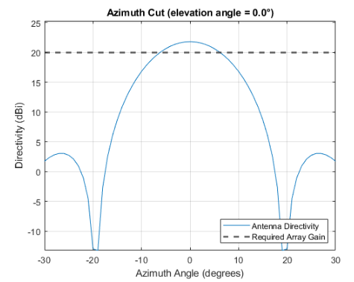
Simulation to Confirm Radar Designer Analysis

Slide 18
Step 2: Antenna Array Susbsystem Design

Slide 19
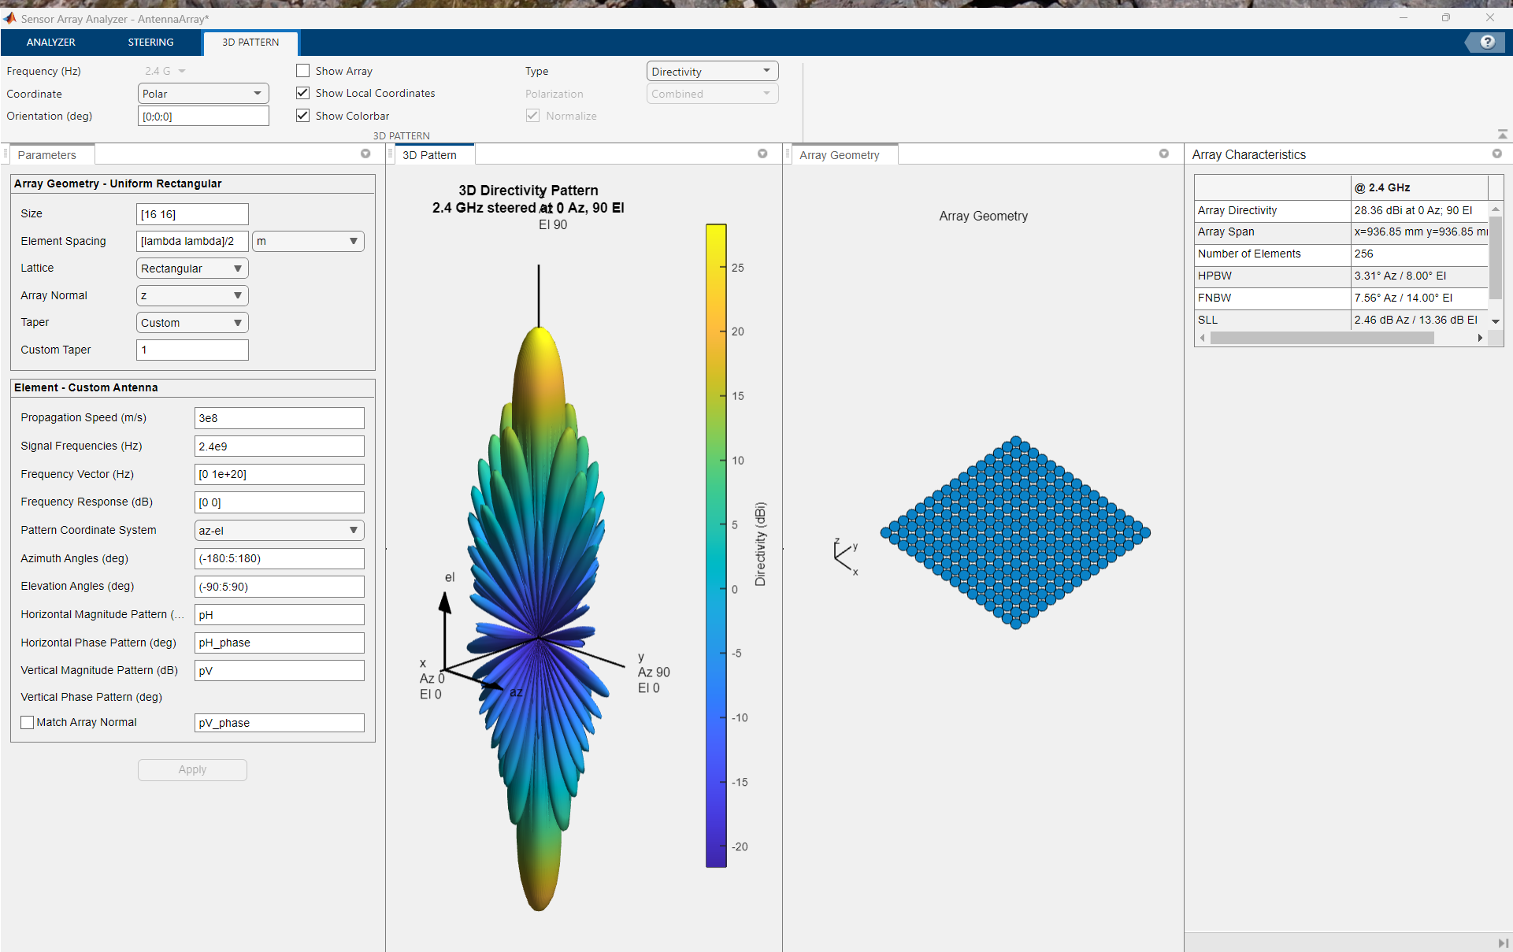
Array Integration: 16x16 Antenna Design
AntennaArray.mat

Slide 20
Step 3: TR Module Integration and Verification

Slide 21
Step 3: Module Integration and Verification
Integrate TR module into baseline model
Add component specifications to TR module and verify results
Redesign components if target detection fails
Integrate full array into simulation
Add phase-shift beamforming

Slide 22
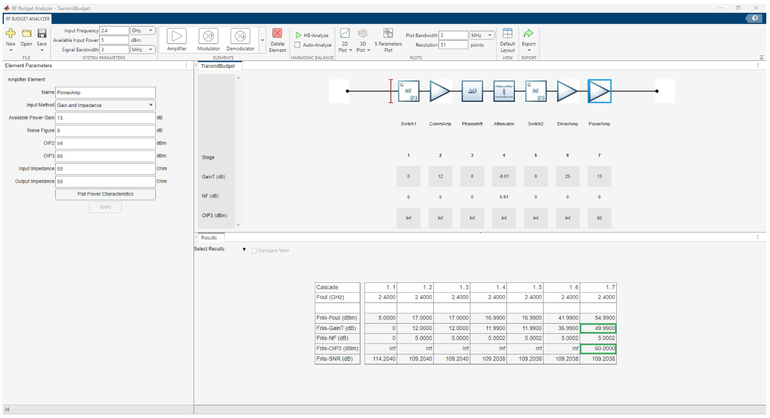
RF Budget Analyzer to Match Transmitter and Receiver Specs

Slide 23
Step 2 - RF Component Design: Analyze First, Simulate Next
Transmitter
Allocate power budget across components
Identify common path
Receiver
Allocate noise budget across components
Identify common path
Antenna
Design dual polarized antenna and determine directivity
Design matching network and maximize power transfer
Integrate antenna in transmitter and receiver
Array
Model array gain and integrate in TX and RX paths

Slide 24
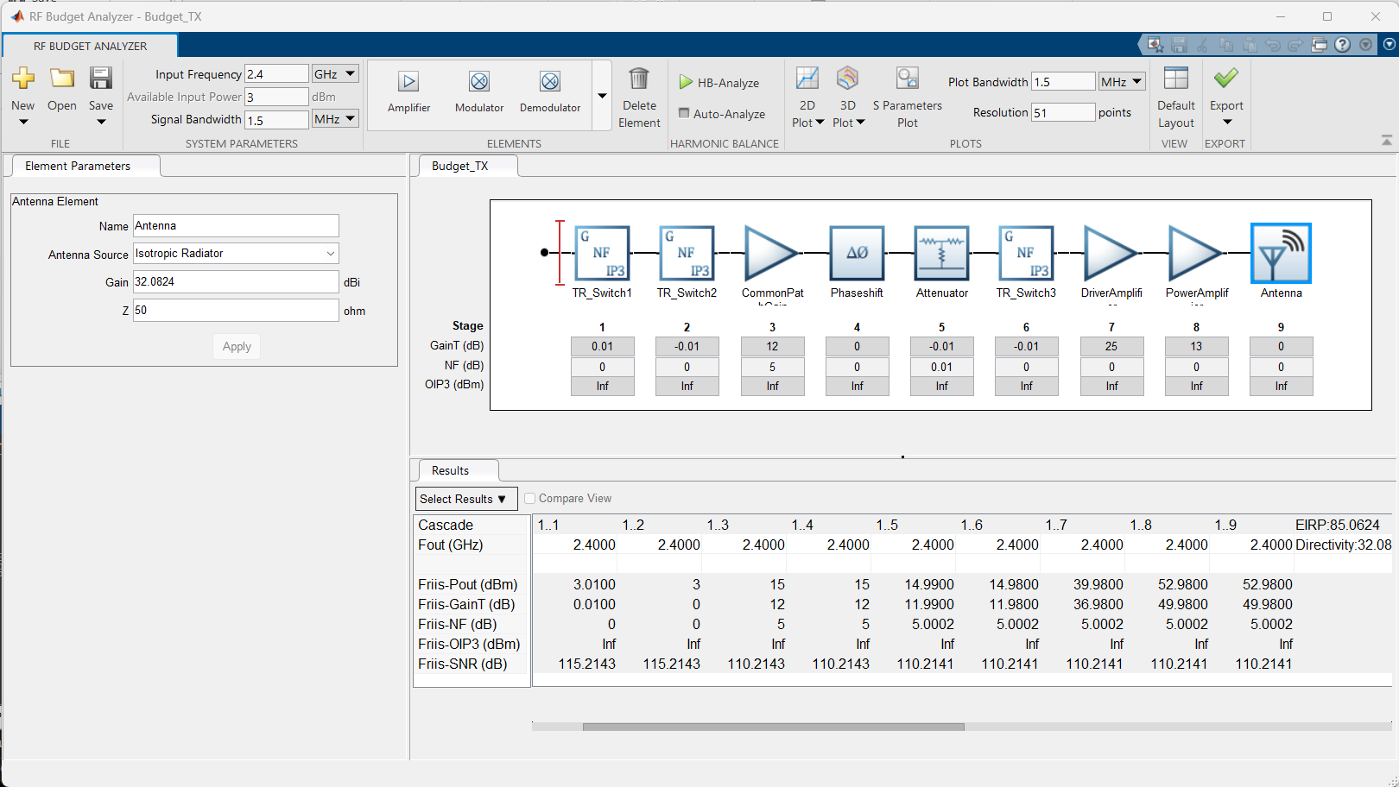
Transmitter Specifications (Baseline)
DEMO
Budget_TX.mat

Slide 25
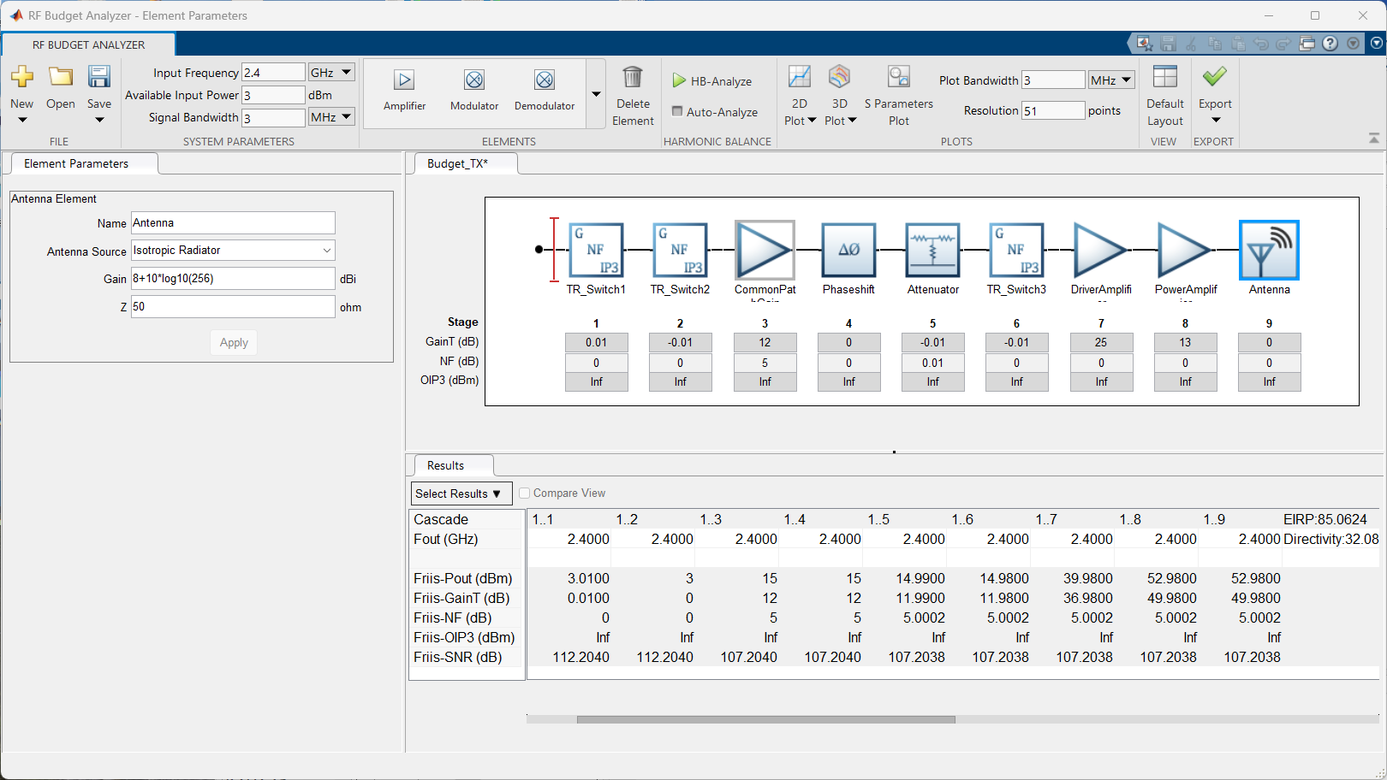
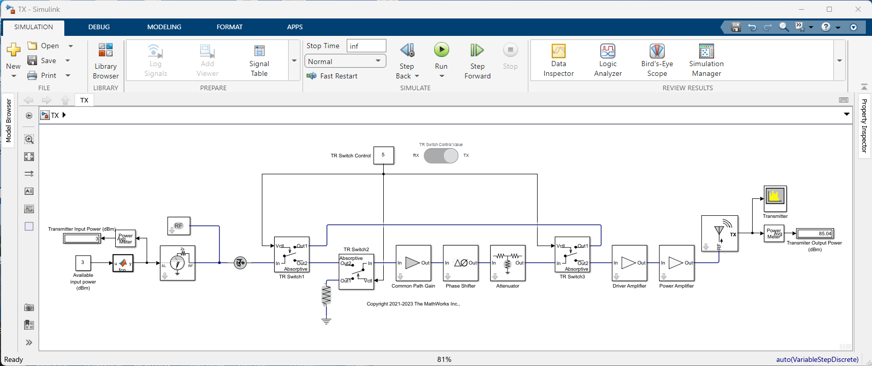
Transmitter Design: Common Path, Switches, and Component Specs
DEMO
EIRP = 85dBm
Pin = 3dBm
Common path
Directivity = 32dBi
TX.slx

Slide 26
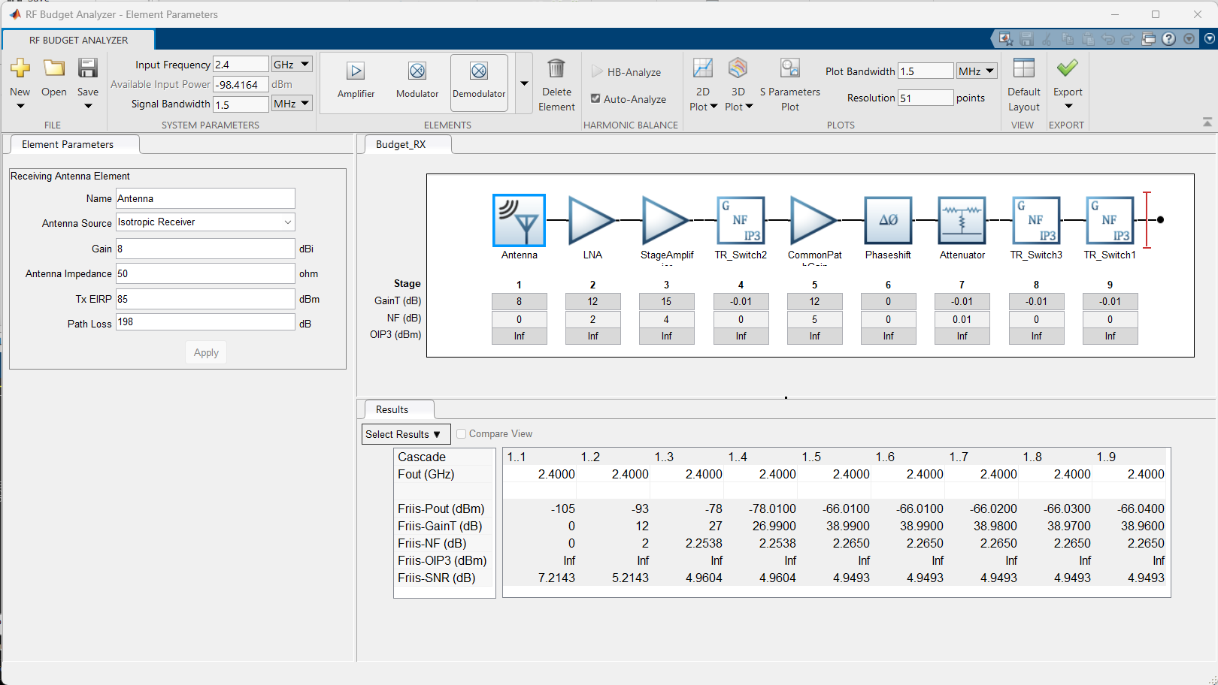
Receiver Specifications (Baseline)
DEMO
Budget_RX.mat

Slide 27
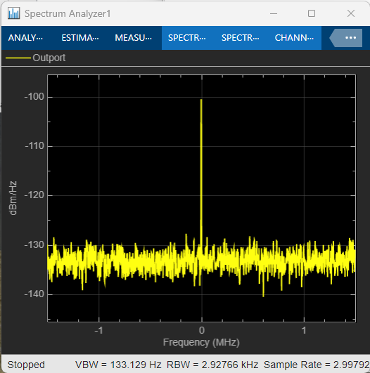
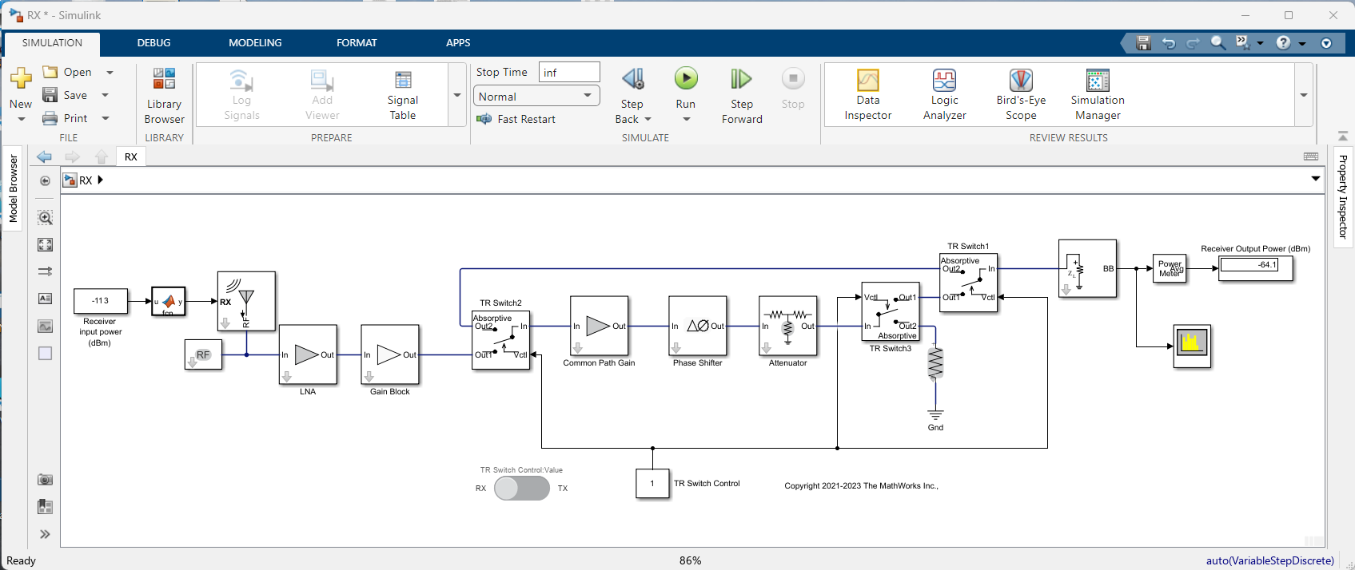
Receiver Design: Common Path, Switches, and Component Specs
DEMO
Pout = -66dBm
SNR ~ 5dB
Directivity = 8dBi
Common path
Pin = EIRP-PathLoss+RCS return =
= 85-228+30 = -113dBm
RX.slx

Slide 28
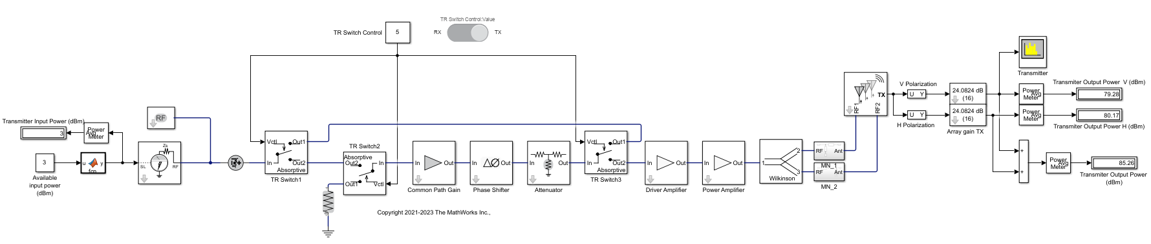
Integrate Transmitter Antenna
DEMO
Array gain
Dual polarized antenna
Pin = 3dBm
EIRP = 85dBm
Matching network
TX_Antenna.slx

Slide 29
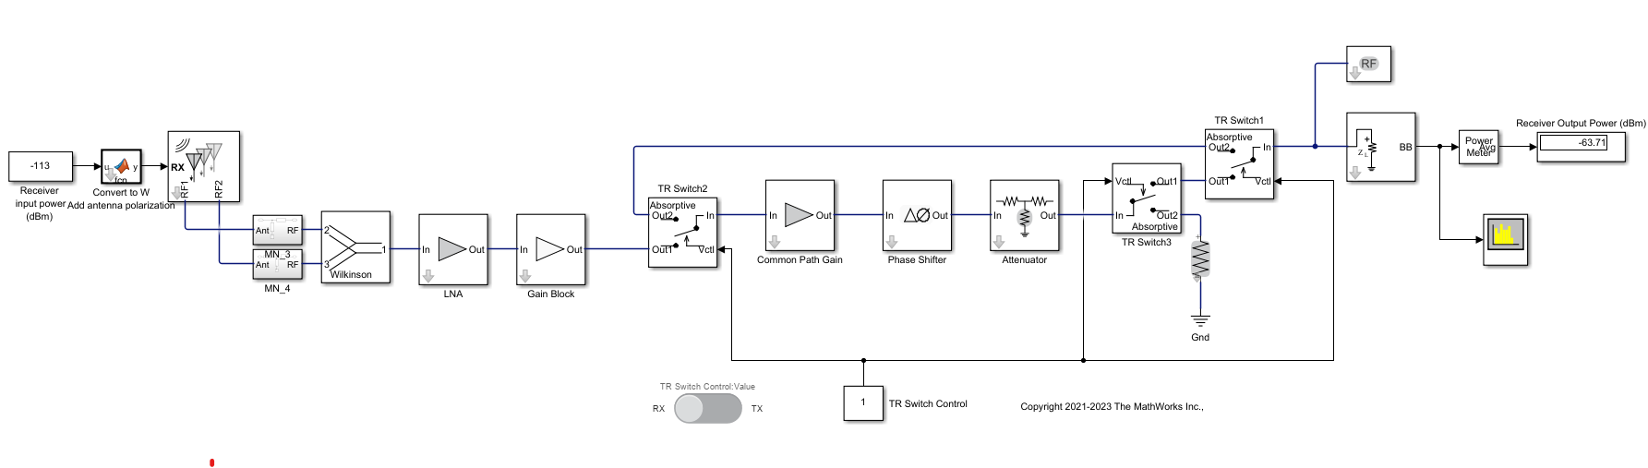
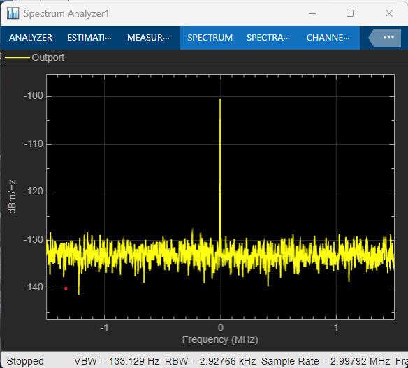
Integrate Receiver Antenna
DEMO
Pin = EIRP-PathLoss+RCS return =
= 85-228+30 = -113dBm
Dual polarized antenna
Matching network
Pout = -66dBm
SNR ~ 5dB
RX_Antenna.slx

Slide 30
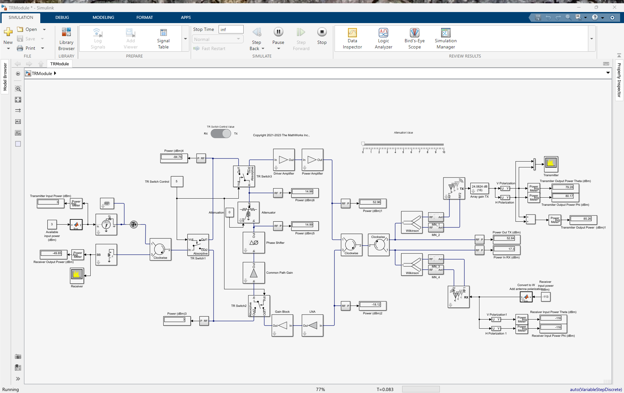
TR Module: TX Mode Power Budget
DEMO
TX in
TX out
RX out
TX power leaking in RX
RX in
Common path
TRModule.slx

Slide 31

TR Module: RX Mode Power Budget
DEMO
RX power leaking in TX
TX in
TX out
RX out
RX in
Common path
TRModule.slx

Slide 32
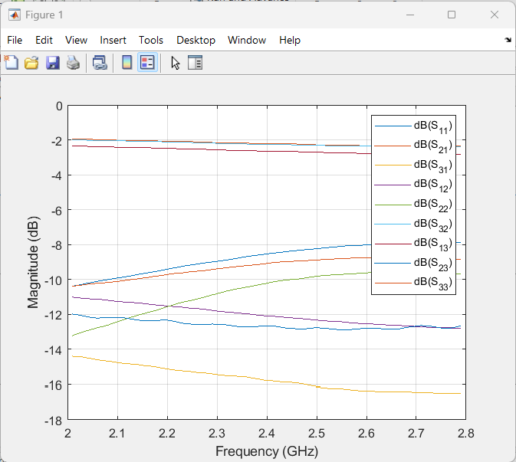
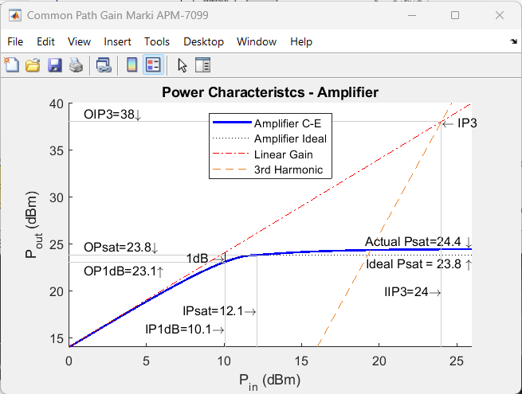
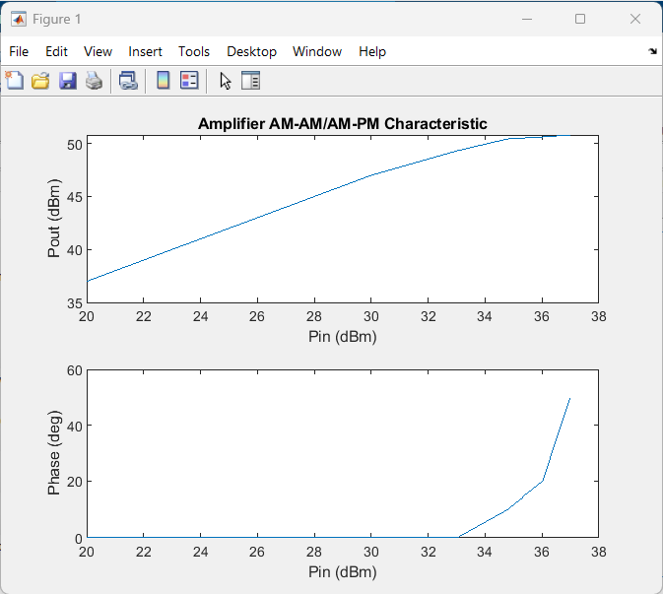
RF Component Modeling Using Measurements and Datasheets
Circulators: S-parameters
Amplifier: S-parameters, IP3, Psat, noise
Power amplifier: AM-AM/AM-PM (Psat ~ 51dBm)

Slide 33
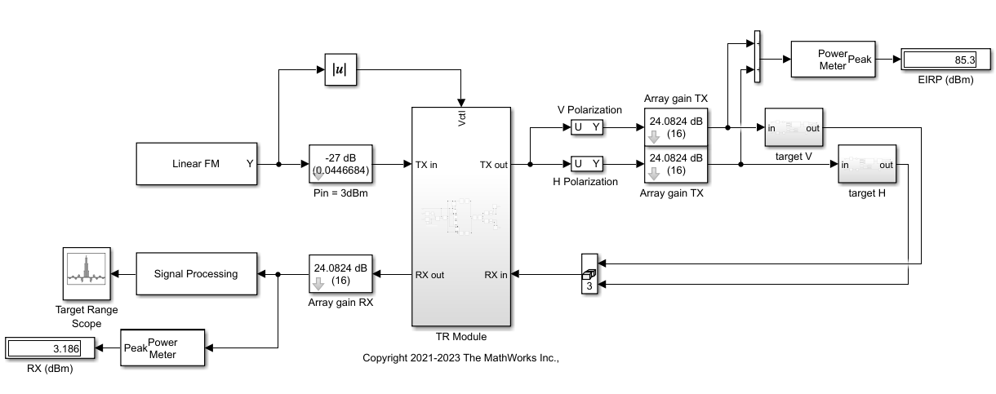
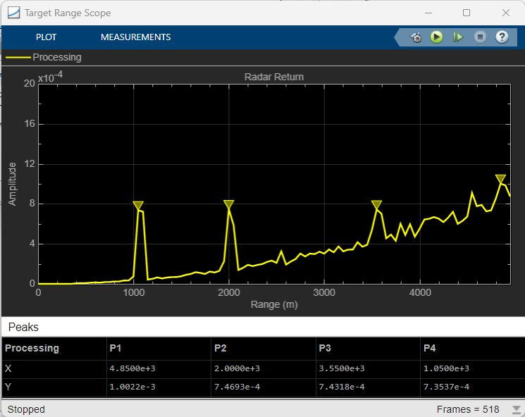
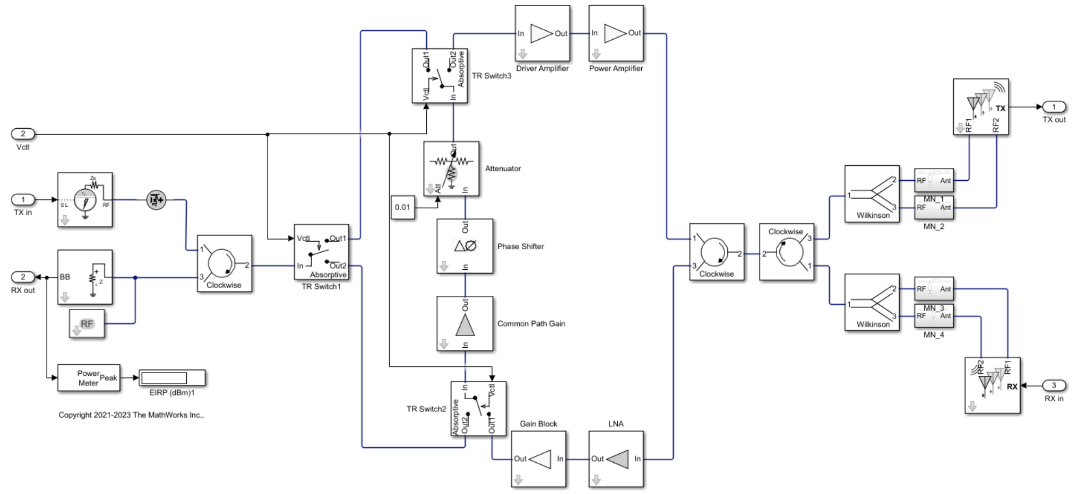

Radar System with TR Module
DEMO
Placeholder antenna array
TR module:
Common path
Gain
Noise
Antenna
RadarSystem_TRM.slx

Slide 34
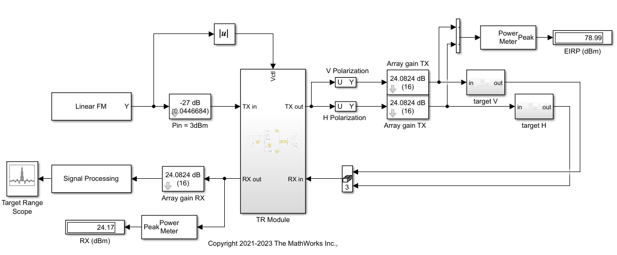
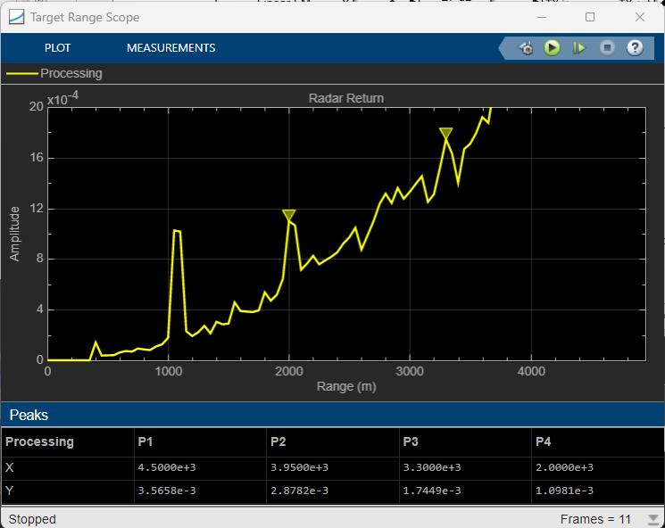
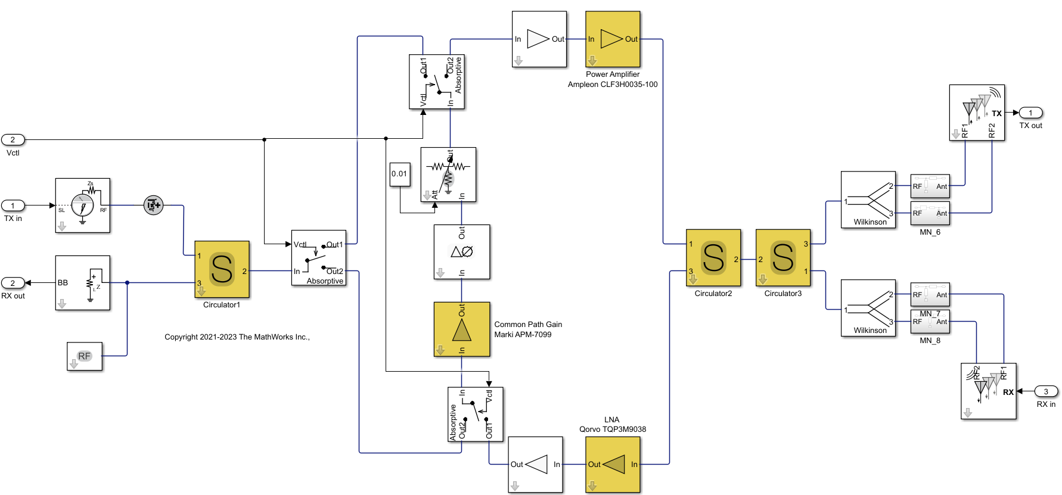

Radar System with TR Module Datasheet Model
DEMO
Placeholder antenna array
TR module:
S-parameters
Non-linearity
Losses
Coupling
RadarSystem_TRM_DataSheets.slx

Slide 35
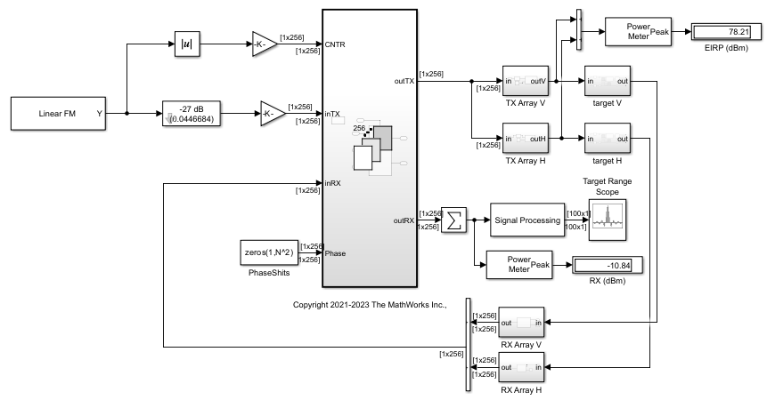




Radar System with TR Module and Full Array
DEMO
Beamforming
Phase-shifts
For-each
Full Array
TR module:
Common path
Gain
Saturation
Noise
Phase-shifts
Leakage
RadarArray_TRM_Idealized.slx

Slide 36



Radar System with TR Module Placeholder and Full Array
DEMO
TR module
TX Gain = 50dB
TX OPsat = 49dBm
RX Gain = 39dB
RX NF = 4dB
For-each
Full Array
RadarArray.slx

Slide 37




Radar System with TR Module Data-Sheet Model and Full Array
DEMO
Beamforming
Phase-shifts
For-each
Full Array
TR module:
S-parameters
AM-AM/AM-PM
Losses and coupling
RadarArray_TRM_DataSheet.slx

Slide 38




Radar System with TR Module and Beamforming
DEMO
Beamforming angle
For-each
Full Array
RadarArray_TRM_Beamforming.slx

Slide 39

Transmitter Specifications (Component Specs)
DEMO
Budget_TX_DataSheet.mat

Slide 40

Transmitter Specifications: HB Analysis – PA in Compression
Saturating amplifier
EIRP ~ 78.5dBm
Budget_TX_DataSheet.mat

Slide 41

Receiver Specifications (Component Specs)
DEMO
Budget_RX_DataSheet.mat

Slide 42

TR Module: TX Mode Power Budget
DEMO
TX in
TX out
RX out
RX in
TX power leaking in RX
Common path
TRModule_DataSheets.slx

Slide 43

TR Module: RX Mode Power Budget
DEMO
RX power leaking in TX
TX in
TX out
RX out
RX in
Common path
TRModule_DataSheets.slx

Slide 44




Architecture + Analysis + Simulation = Digital Twin
Architecture
Interfaces and requirements
digital thread
Analysis
Specifications
digital thread
Fidelity (Abstraction )
Simulation
Design and verification
System & component complexity
Notes:
Let’s begin our systems engineering phase with an architectural design and some requirements allocation.
These first two insets show a simple radar architecture at the top level and also a radar front-end that is one-level down in the hierarchy.
<CLICK>
For this work, we’re using a pair of tools called System Composer and Requirements Toolbox. These tools can be used for any system design, not just for radars.
System Composer provides a graphical modeling interface similar to many SYSML design tools. In can also import and export architectures with 3rd party tools.
And it is integrated with Requirements Toolbox which as its name suggests is for requirements management.
Requirements Toolbox also allows import and export with requirements spreadsheets, common requirements databases, and text document formats.
For today, that’s as far as we’ll go with architecture and requirements. But you get the idea.
<CLICK>
The tool shown on the right is our first stab at the power level analysis of our radar. Here we’re using a tool called radar designer.
We’ll go into more detail shortly but in a nutshell, Radar Designer is where you would begin to specify your targets and environments and start selecting waveform parameters
that would be suitable for meeting your performance specification.

Slide 45
Conclusions
Use Model-Based Design from Radar specifications to RF component design
Integrate measurements and data sheet parameters
Analyze the impact of RF effects on the overall radar performance
Track requirements, specification changes, and automate testing

Slide 46

New Training Offering: Modeling Radar Systems with MATLAB
Course Details
This two-day course provides a comprehensive introduction to radar system design and modeling with a focus on Radar Toolbox™.
Topics include:
Radar systems engineering for preliminary radar design
Scenario generation including targets, propagation, and terrain
System simulation at the measurement and physics (IQ signal) level
Signal processing for target detection
Data processing for multi-object tracking
Higher fidelity modeling including antenna array design, waveform analysis, clutter, polarization, and micro-Doppler signature generation
Radar data synthesis and labeling for deep learning
Modeling Radar Systems with MATLAB

